Slide 1
CS 2212
Introduction to Software Engineering
Chapter 1 Key Principles – Software Life Cycle - Process

Slide 2
Copyright Notice This Presentation and Its Associated Video Contain Copyright Material. This Presentation and Its Associated Video Are Provided for Teaching Purposes of CS2212 and Should Not Be Posted In Any External Site, Or Shared with. This Presentation and Its Associated Video Are Provided For Instructional Personal Use Only, and Only For The Purposes of the CS2212 Course.

Slide 3
Part 1
Key Software Engineering Principles
Truth can only be found in one place: the code.
- Robert C. Martin
Notes:
This lesson introduces the basic steps in a software engineering project at a high level.
In practice, steps often overlap.

Slide 4
Learning Objectives in this Part
To define Software Engineering as an engineering discipline
To discuss and disambiguate certain myths about software development

Slide 5
What is Software Engineering ?
It is an area of Computer Science which relates to techniques, methods, practices and tools for the application of a systematic, disciplined, quantifiable approach to the development, operation, and maintenance of software; that is, the application of engineering to software.
The study of approaches as in (1) in order to develop high quality products within the specified budget and time.
[IEEE Standard 610.12]

Slide 6
Distinct and Complementary Roles
Computer Scientist
Aims for providing theorems and properties of algorithms, designing new programming languages, defining new information modeling formalisms etc.
A Computer Scientist usually has unlimited time to complete his/her task
Engineer
Designs and oversees the implementation of a specific technical problem and project in a specific application domain
An engineer uses computers, programming languages, techniques, and tools
Software Engineer
Usually works on the design of software systems and oversees the implementation of a specific technical software projects in different application domains
Has 3 months to design a solution ….
…while user requirements and available technology constantly change … ☹

Slide 7
Routes for Software Systems
Computer Scientist
Needs &
Problems
Finds a theoretical solution
Theoretical solution on specific data
Finds a hybrid
solution
Finds practical
solution
Software Engineer
Software Engineer
Software
System

Slide 8
Your Turn
Why do we need software engineering practices? Isn’t programing just enough to build software?
What are the common roles of a scientist, a computer scientist, and a software engineer with respect to developing software systems?
What are the artifacts produced as a result of a software engineering project?
Read the content of the following sites:
https://en.wikipedia.org/wiki/Software_engineering
https://www.ibm.com/topics/software-development
https://www.d.umn.edu/~gshute/softeng/principles.html

Slide 9
Software Myths
Myth #1: We already have a book that’s full of standard and procedures for building software. Won’t that provide my people with everything they need to know?
Reality: Is this book used? Are people aware of its existence? Does it reflect modern software engineering practice? Is it complete? Is it adaptable? Chances are, the answers to these questions is no.

Slide 10
Software Myths
Myth #2: If we get behind schedule, we can add more programmers and catch up (sometimes called the ”Mongolian Horde” technique).
Reality: Adding people to a late software project makes it later. As new people are added, people who were working must spend time educating the newcomers, thereby reducing the amount of time spent on productive development effort. People can be added, but only in a planned and well coordinated fashion.

Slide 11
Software Myths
Myth #3: If I decide to outsource a software project to a third party, I can just relax and let that firm build it.
Reality: If an organization does not how to manage and control software projects internally, it will invariably struggle when it outsources software projects too.

Slide 12
Software Myths
Myth #4: A general statement of objectives is sufficient to begin writing programs – we can fill in the details later.
Reality: Although a comprehensive and stable statement of requirements is not always possible, an ambiguous “statement of objectives” is a recipe for disaster. Effective and continuous communication between customer and developer is necessary.

Slide 13
Software Myths
Myth #5: Software requirements continually change, but change can be easily accommodated because software is flexible.
Reality: While software requirements can change, the impact of the change varies with the time at which it is introduced. The later changes are introduced, the more problematic they are, as great portions of design and/or code might need to be discarded and redone.

Slide 14
Software Myths
Myth #6: Once we write the program and get it to work our job is done.
Reality: Someone once said that “the sooner you begin ‘writing code’ the longer it’ll take you to get done”. Industry data indicate that between 60 and 80 percent of all effort expended on software occurs after delivery to the customer for the first time.

Slide 15
Software Myths
Myth #7: Until I get the program running, I have no way of assessing its quality.
Reality: One of the more effective software quality assurance mechanisms, the technical review, can be applied from the start of a project. Do not wait until the end to start assessing quality!

Slide 16
Software Myths
Myth #8: The only deliverable work product for a successful project is the working program.
Reality: A working program is only part of the solution. A variety of work products (e.g. models, documents, plans) provide a foundation for successful engineering and guidance for software support.

Slide 17
Software Myths
Myth #9: Software engineering will make us create voluminous and unnecessary documentation and work and will invariably slow us down.
Reality: Software engineering is about creating a quality product. (Yes, some documentation and extra effort is required for this.) Better quality leads to reduced rework, and this reduced rework results in faster delivery times than possible otherwise.

Slide 18
Your Turn
Why the existence of standards (e.g. ISO, IEEE) are not enough when developing software systems?
A project runs late. Why adding more developers won’t fix the problem?
From the perspective of a client who commissions a new software project, what are the issues to be aware when outsourcing the development to a third party?
Can we assess the quality related of a software system being built before we complete coding the whole system?
Read the content of the following sites:
https://www.softwaretestinghelp.com/what-is-sei-cmm-iso-ieee-ansi-will-it-help/
https://stackoverflow.blog/2019/10/01/pitfalls-avoid-outsourcing-software-development/
https://en.wikipedia.org/wiki/Software_development_effort_estimation

Slide 19
Part 2
Dealing with Complexity
There are two ways of constructing a software design. One way is to make it so simple that there are obviously no deficiencies. The other way is to make it so complicated that there are no obvious deficiencies. The first method is far more difficult.—C.A.R. Hoare
Notes:
This lesson introduces the basic steps in a software engineering project at a high level.
In practice, steps often overlap.

Slide 20
Learning Objectives in this Part
To obtain a first look on the guiding principles and approaches software engineers use to handle complexity towards developing large scale systems

Slide 21
Dealing with Complexity
Abstraction
Modeling and Object Orientation helps
Decomposition
Cohesion, Coupling, Modularity
Hierarchy
Specializations, Generalizations

Slide 22
Principles that Guide Practice
Principle #1. Divide and conquer. Stated in a more technical manner, analysis and design should always emphasize separation of concerns (SoC), subdividing large problems into a collection of elements (or concerns) that are easier to address.
Principle #2. Understand the use of abstraction. At its core, an abstraction is a simplification of some complex element of a system used to communicate meaning in a single phrase.
Principle #3. Strive for consistency. A familiar context makes software easier to specify, built, test, and, use.

Slide 23
Principles that Guide Practice
Principle #4. Focus on the transfer of information. Software is all about information transfer, and there are risks of error, omission, or ambiguity. Pay special attention to the analysis, design, construction, and testing of interfaces as information flows across these junctures.
Principle #5. Build software that exhibits effective modularity. Separation of Concerns (Principle #1) establishes a philosophy for software. Modularity provides a mechanism for realizing this philosophy.

Slide 24
Principles that Guide Practice
Principle #6. Look for patterns. Brad Appleton suggests that: “The goal of patterns within the software community is to create a body of literature to help software developers resolve recurring problems encountered throughout all of software development.”
Principle #7. When possible, represent the problem and its solution from a number of different perspectives.
Principle #8. Remember that someone will maintain the software. Maintenance activities can be facilitated if solid software engineering practice is applied throughout the software process.

Slide 25
Part 3
Software Applications
Inside every large program is a small program struggling to get out.
—Tony Hoare
Notes:
This lesson introduces the basic steps in a software engineering project at a high level.
In practice, steps often overlap.

Slide 26
Learning Objectives in this Part
To discuss types of software applications which currently dominate the market and pose development challenges

Slide 27
Software Applications
System software
Application software
Engineering/scientific software
Embedded software
Product-line software
Web/mobile applications
AI software (robotics, neural nets, etc.)

Slide 28
The Changing Nature of Software
While we still have to deal with legacy software, a lot has changed and evolved over the years
Some categories now dominate the software landscape that were in their infancy little more than a decade ago:
Web apps
Mobile apps
Cloud computing

Slide 29
Web Apps
Modern web apps are often much more than hypertext files with accompanying graphics and other media content, though those elements are still a key aspect of web apps
They are augmented with tools to give interactive computing capability and can be integrated with massive corporate databases and sophisticated business applications
The aesthetic nature of the content remains an important determinant of the quality of a web app

Slide 30
Web Apps
Unlike conventional application software that evolves over a series of planned, chronologically-spaced releases, web app can evolve and be released continuously (referred to as continuous software engineering)
Although immediacy—the need to get software to market quickly—is a characteristic of many application domains, web apps often exhibit a time to market that can be a matter of a few days or weeks
Because web apps are available via network access, it is difficult, if not impossible, to limit the population of end-users who may access the application and so security is an important issue

Slide 31
Mobile Apps
Reside on mobile platforms (for example iOS and Android) on devices like phones or tablets
Take advantage of unique interaction mechanisms provided by the mobile platform and devices (touch screens, accelerometer, vibration feedback, location via GPS, etc.)
Often provide access to a combination of web-based resources and local device processing and storage capabilities
Typically provide persistent storage capabilities on the device, but can also leverage remote cloud storage

Slide 32
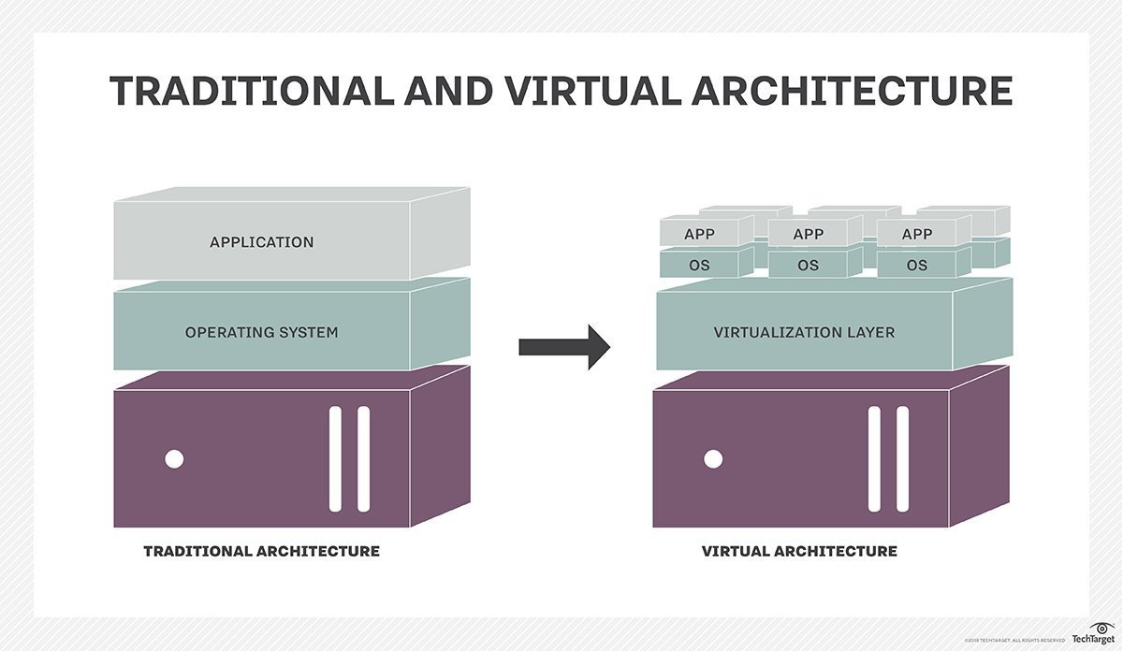
Cloud Computing
Cloud computing is a system-wide architectural paradigm which allows for the on-demand provision of resources (application software, platform, infrastructure) through virtualization technologies
Virtualization technologies allow for the creation of a virtual (rather than actual) version of computer hardware platforms, storage devices, and computer network resources.
Actual
hardware
platform
Actual
hardware
platform
https://searchservervirtualization.techtarget.com/definition/virtualization

Slide 33
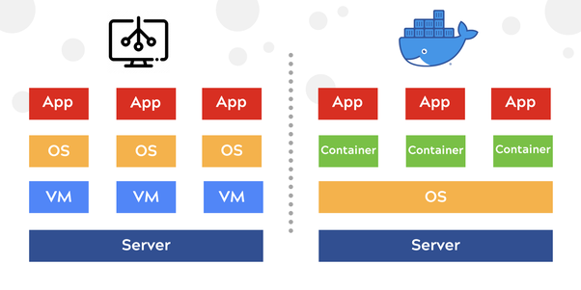
From Virtual Architectures to Microservices
Actual
hardware
platform
Actual
hardware
platform

Slide 34
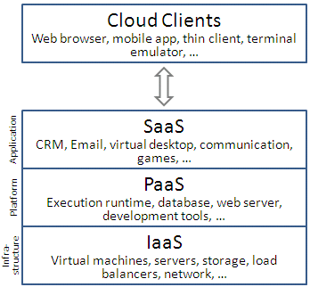
Cloud Computing
Cloud computing requires developing an architecture containing a collection of both frontend and backend services
Frontend services include the client devices and application software to allow access to what is hosted on the cloud
Backend services include servers, data storage, and server-resident applications residing in the cloud
https://commons.wikimedia.org/w/index.php?curid=18327835

Slide 35
Your Turn
What is modularity in software design and why is it important?
What is the concept of abstraction in software engineering? Briefly discuss three examples of abstraction.
With respect to software development, what are the major challenges presented by Web applications, Mobile applications, and Cloud applications?
Read the content of the following sites:
https://en.wikipedia.org/wiki/Modular_programming
https://en.wikipedia.org/wiki/Abstraction_(computer_science)
https://www.tutorialspoint.com/software_architecture_design/hierarchical_architecture.htm
https://en.wikipedia.org/wiki/Component-based_software_engineering
https://en.wikipedia.org/wiki/Web_application
https://en.wikipedia.org/wiki/Cloud_computing
https://www.tutorialspoint.com/software_architecture_design/hierarchical_architecture.htm

